Slide 1



CAP 3104 Human and Technology Interaction Assignment 5 Group #2

Slide 2
Cohesive Teamwork
Working together as a cohesive team
Valeria: Project Manager and Requirements Verification
Grace: Requirements Manager and Documentation
Keegan: Graphic Artist
Amani: UI Designer

Slide 3
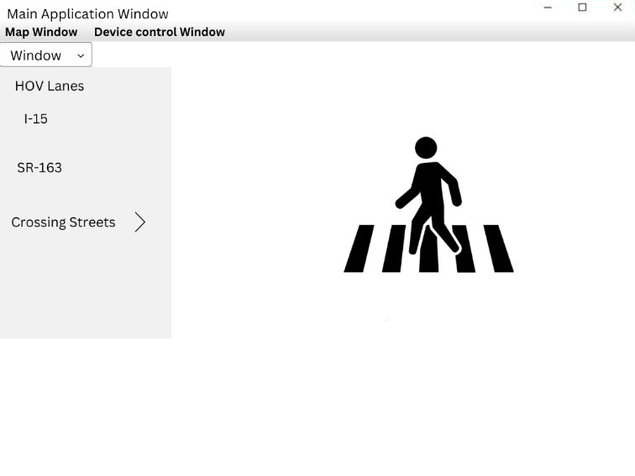
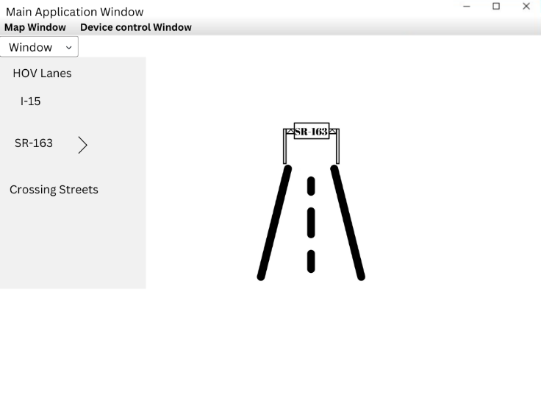
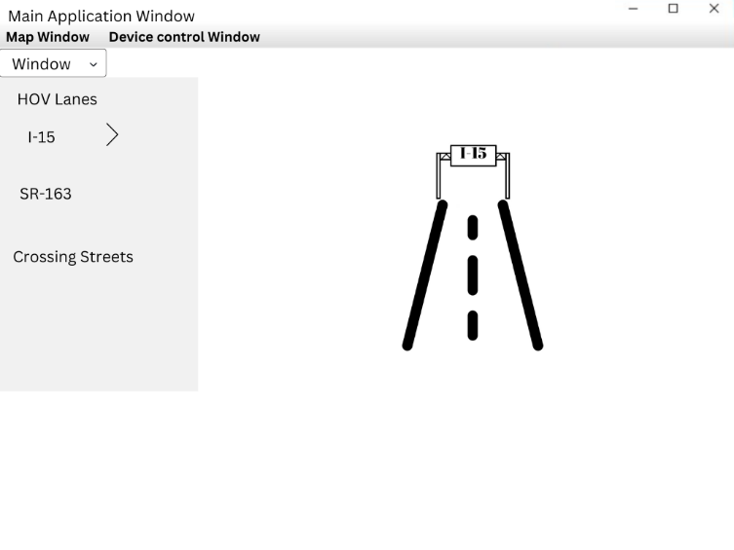
Map Window
3.3.1.1 The map window shall display the HOV lanes, the adjacent lanes of I-15 and SR 163, crossing streets and their interchange, if any, and icons.

Slide 4
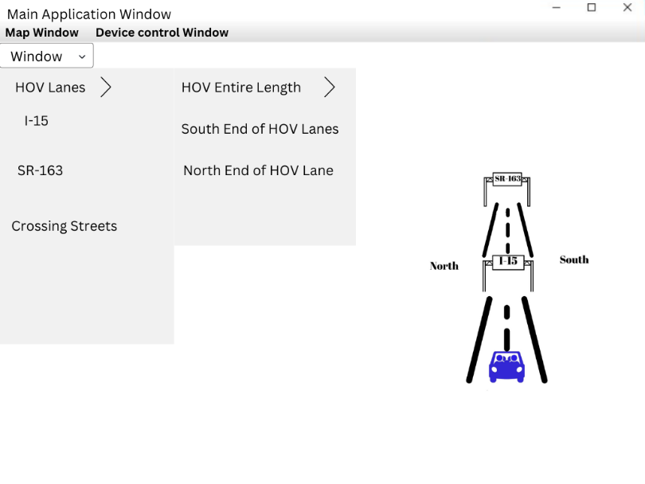
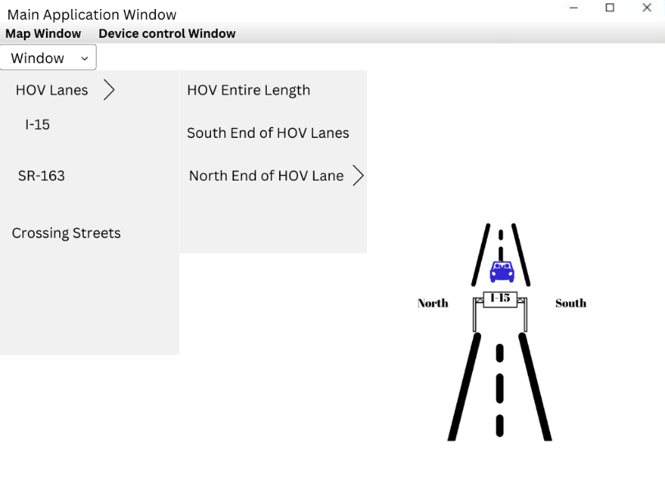
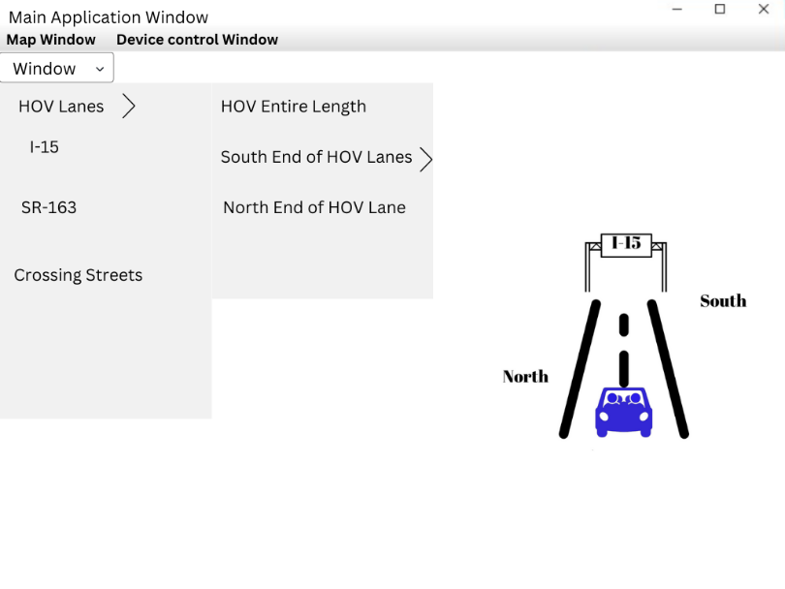
Map Window
3.3.1.2 Three map windows shall be provided: one showing the entire length of the HOV lanes, one showing a detail of the south end of the HOV lanes and one showing a detail of the North end of the HOV lanes.

Slide 5
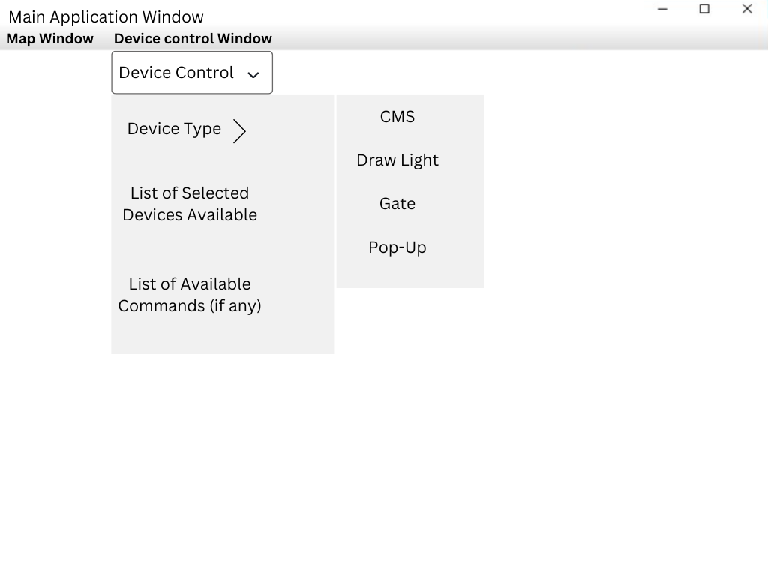
Command Toolbar
3.3.2.1 The Command Toolbar shall allow a user to select a window for display.
3.3.2.2 The Command Toolbar shall always be displayed to the user.
3.3.2.3 The Command Toolbar shall only display valid commands.

Slide 6
Device Control Window
3.3.3.1.1 The device control window shall display a three level menu allowing the operator to select the device to be commanded.
3.3.3.1.1.1 The first level shall be the device type selection: CMS, draw light, gate, pop-up, etc.
3.3.3.1.1.2 The second level shall be a list of specific devices of that type that are available to be commanded.
3.3.3.1.1.3 The third level shall be a list of available commands (if any) for the selected device.

Slide 7
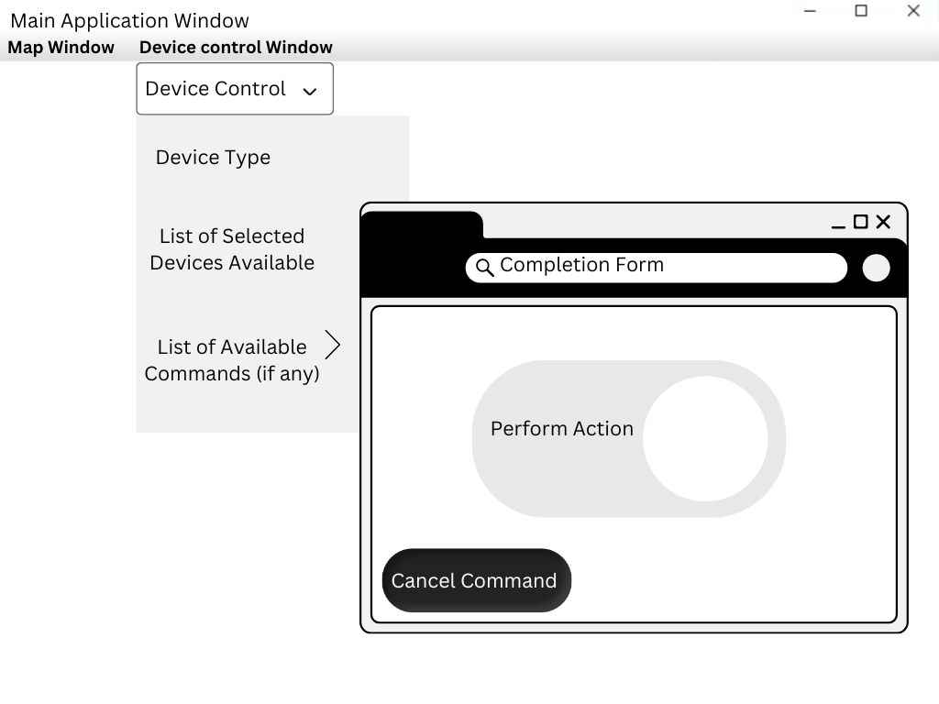
Device Control Window
3.3.3.1.2 Once the device type, device and command have been selected via the menu system the operator shall be presented with a form for the completion of any parameters for the command.
3.3.3.1.3 The device command completion form shall have a button labeled “Perform Action” to allow the operator to execute the command.
3.3.3.1.3.1 The “Perform Action” button shall be grayed out and unselectable until the device command form has been filled out.
3.3.3.1.3.2 The “Perform Action” button shall log the command submittal.
3.3.3.1.4 The device command completion form shall have a button labeled “Cancel Command” to allow the operator to stop the completion of the command.

Slide 8
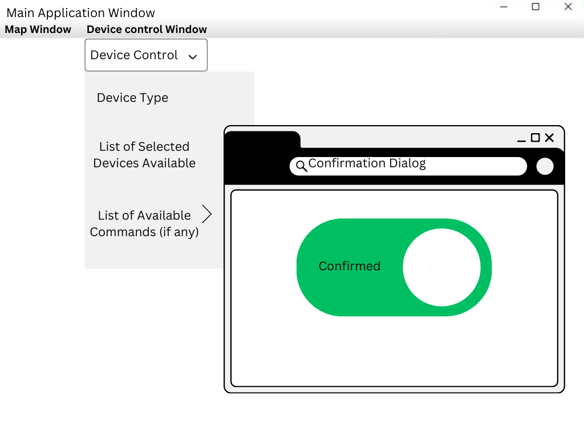
Device Control Window
3.3.3.2 Confirmation Dialog

Slide 9
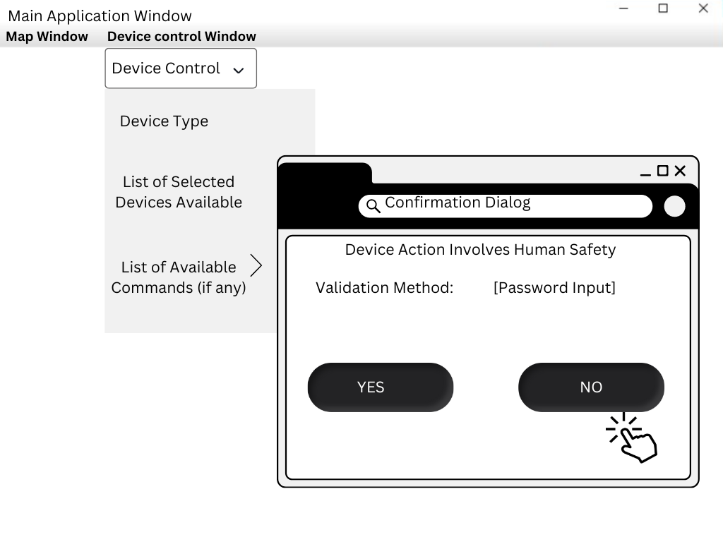
Device Control Window
3.3.3.2.1 Any device control action that involves human safety shall use a confirmation dialog to validate the action.
3.3.3.2.1.1 All device actions defined in the detailed design shall be classified as either involving human safety or not involving human safety.
3.3.3.2.1.2 The default classification shall be that the device action involves human safety.
3.3.3.2.2 The required validation method (if any) shall be displayed with the confirmation dialog.
3.3.3.2.3 The confirmation dialog shall specify the action and prompt the user for a YES or NO to continue.
3.3.3.2.4 The confirmation dialog shall default to NO.

Slide 10
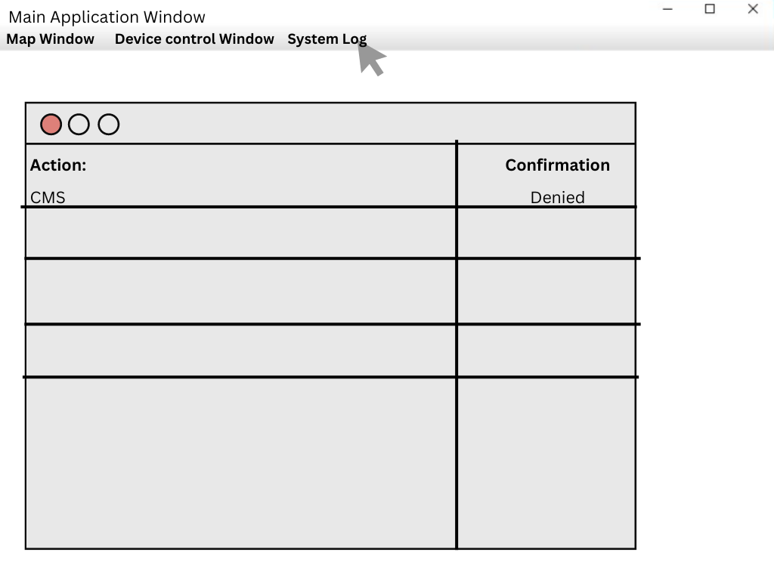
Device Control Window
3.3.3.5 If the requested device control command results in multiple steps at the field control level, the intermediate steps and their status shall be displayed in the device control window.
3.3.3.3 The action and the confirmation shall be displayed in the System Log window.
3.3.3.4 The device control window shall display any returned device status resulting from the device control command.

Slide 11
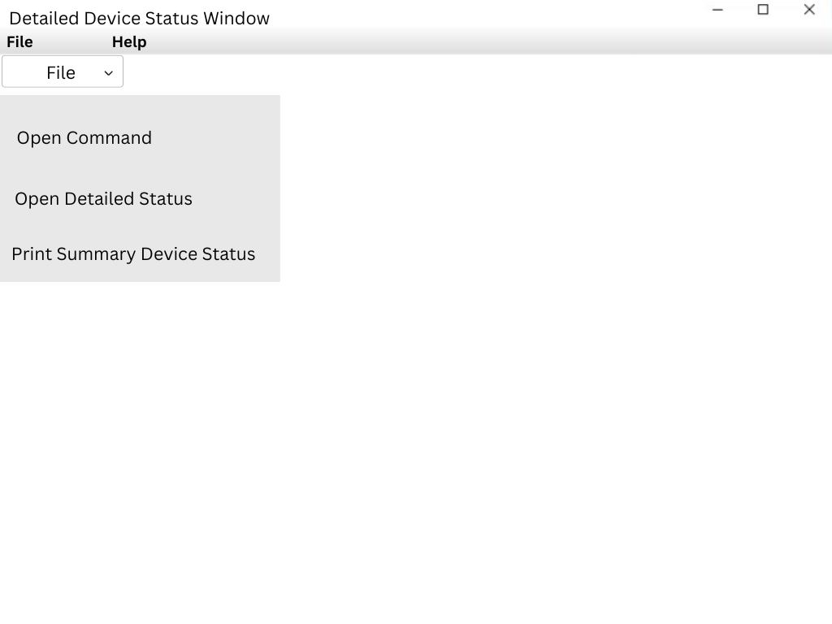
Summary Device Status Window
3.3.4.1 The summary device status window shall display a text and graphic summary presentation on the status of the selected device or group of devices.

Slide 12
Detailed Device Status Window
3.3.5.1 The detailed device status window shall display a text and graphic presentation on the status of the selected device or group of devices.
3.3.5.2 The detailed device status window shall allow a user to select more detailed status information on an individual device.
3.3.5.3 The operator shall be able to call up a device control window for any device shown on the device status window.
3.3.5.4 The summary device status window shall have a menu bar with File and Help as a minimum.
3.3.5.4.1 The File menu item shall include an option to open a command window for the selected device.
3.3.5.4.2 The File menu item shall include an option to open a detailed status window for the selected device.
3.3.5.4.3 The File menu item shall include an option to print the summary device status page.

Slide 13
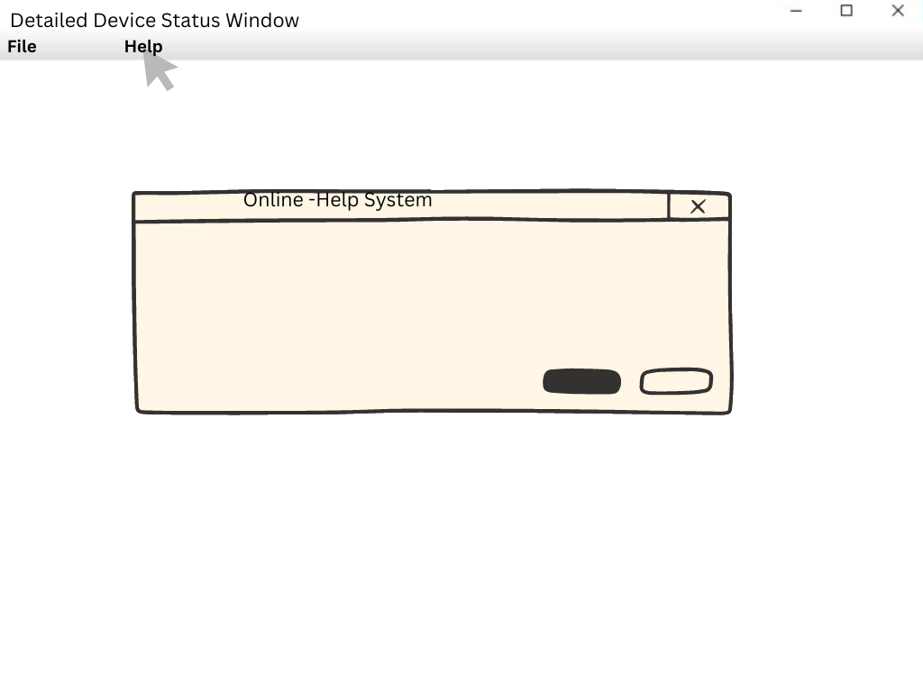
Detailed Device Status Window
3.3.5.4.4 The Help menu item shall activate the on-line help system.

Slide 14
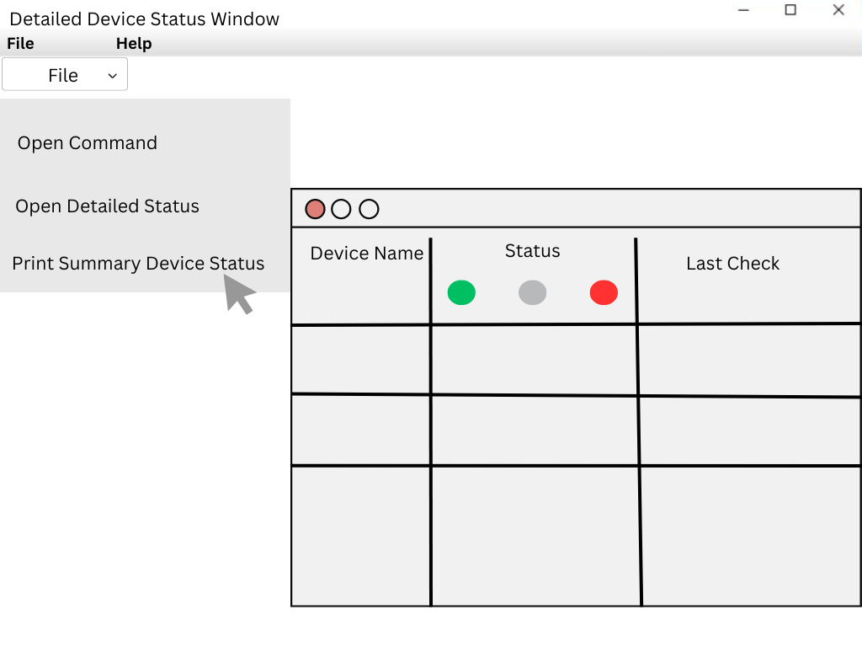
Detailed Device Status Window
3.3.5.5 The summary device status window shall display a list of all devices along with a miniature icon of the device color coded with the device status. The color-coding shall match the color-coding described above.
3.3.5.6 The summary device status window shall list the full name of each device.
3.3.5.7 The summary device status window shall list the most reason error code and description for the device if the device is failed or experiencing errors.
3.3.5.8 The summary device status window shall list the time and date of the last device status check.

Slide 15
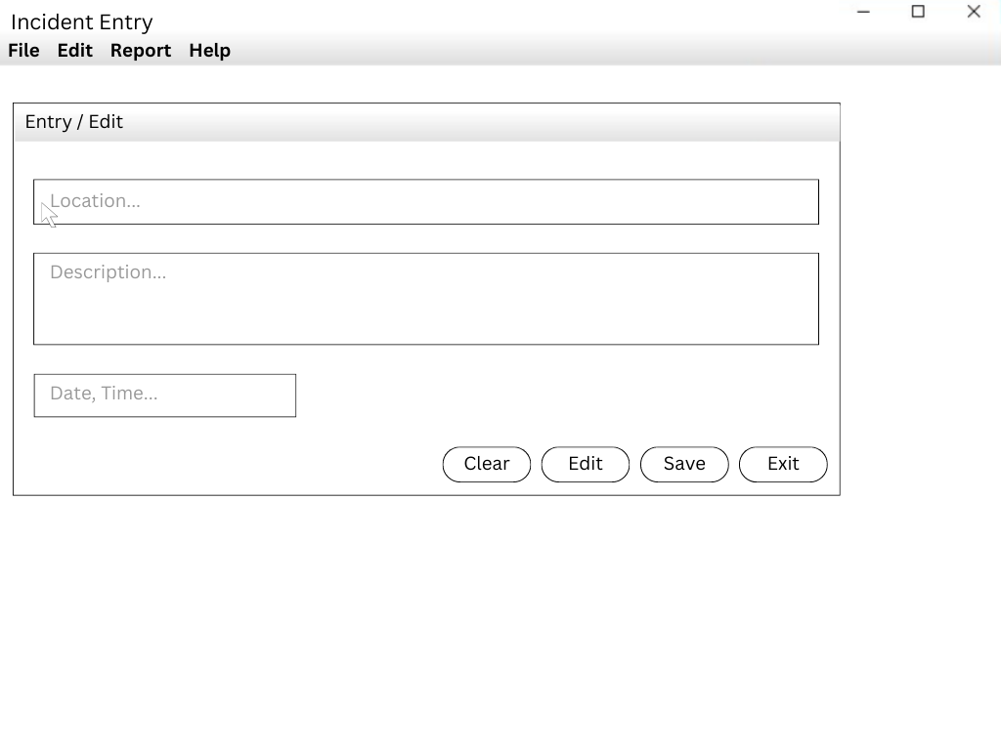
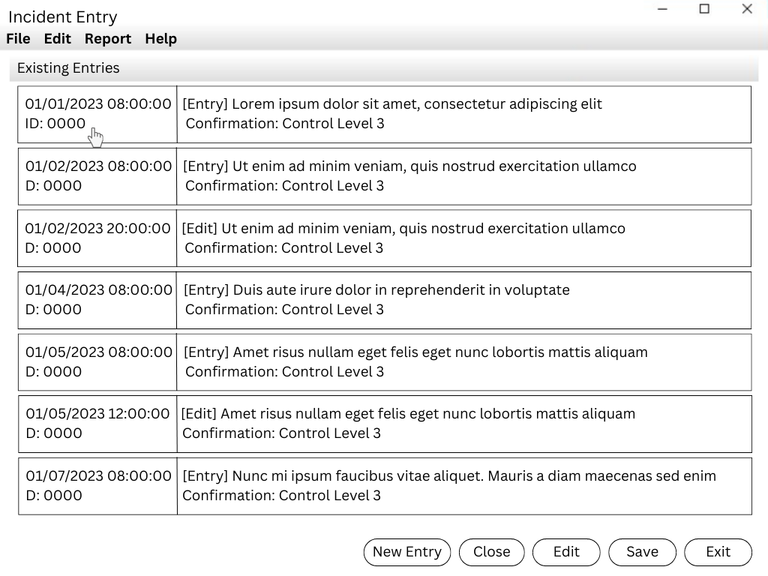
Incident Entry / Edit Window
3.3.6 This window shall enable the user to enter and edit an incident report to displayed as an icon on the map window.
3.3.6.1 A user shall be able to enter information on an incident, including, location, description and time period.
3.3.6.2 A user shall be able to edit or close an existing incident.

Slide 16
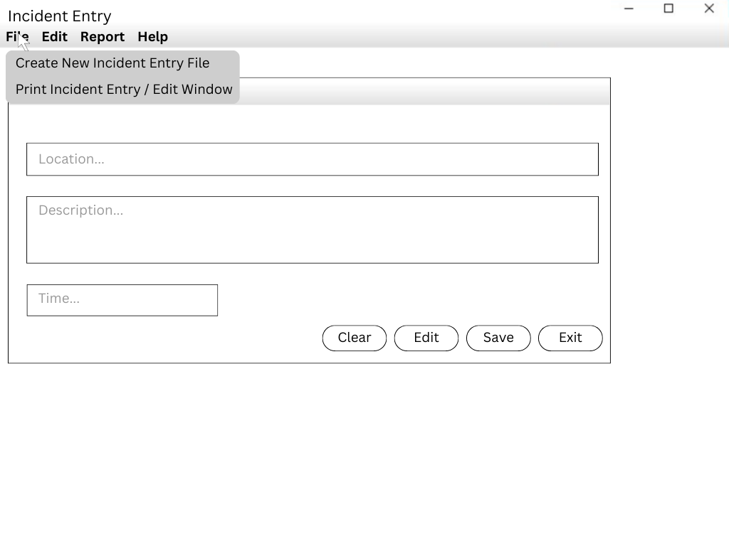
Incident Entry / Edit Window
3.3.6.4 The Incident Entry / Edit Window shall have a menu bar with File, Edit, Report, and Help.
3.3.6.4.1 The File menu item shall have an option to create a new incident entry.
3.3.6.4.2 The File menu item shall have an option to print the Incident Entry / Edit Window.

Slide 17
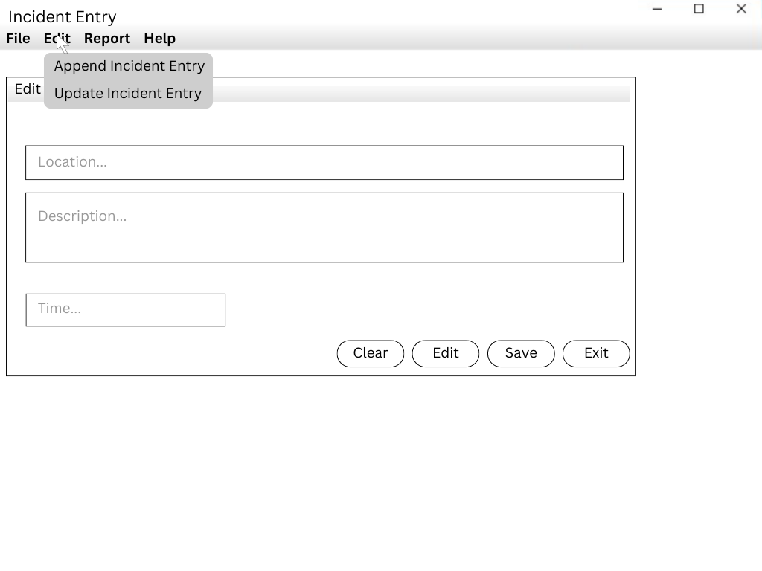
Incident Entry / Edit Window
3.3.6.4.3 The Edit menu item shall have an option to append information to an incident entry.
3.3.6.4.4 The Edit menu item shall have an option to update the information on an incident entry.

Slide 18
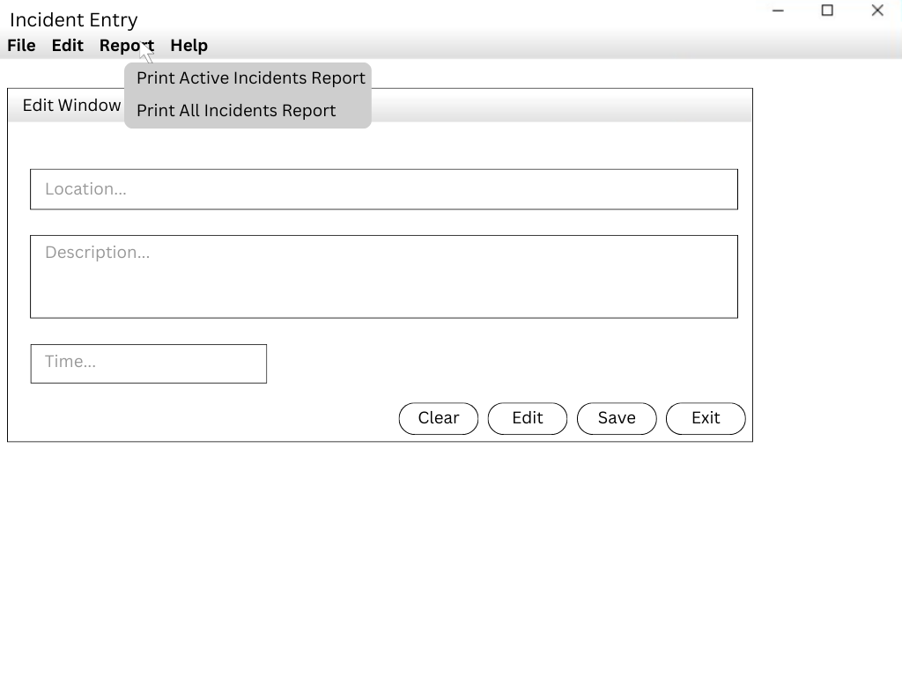
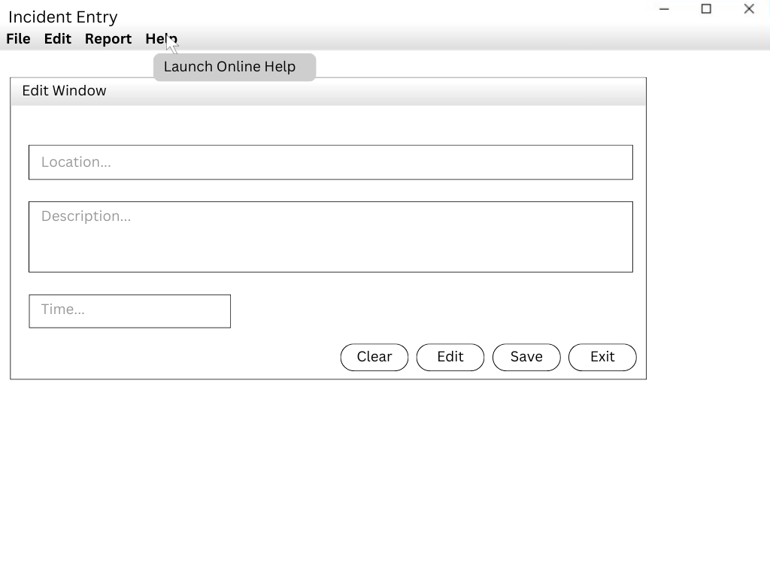
Incident Entry / Edit Window
3.3.6.4.5 The report menu shall have an option to print a report on all active incidents.
3.3.6.4.6 The report menu shall have an option to print a report on all entries associated with a specific incident.
3.3.6.4.7 The Help menu item shall invoke the Help system.

Slide 19
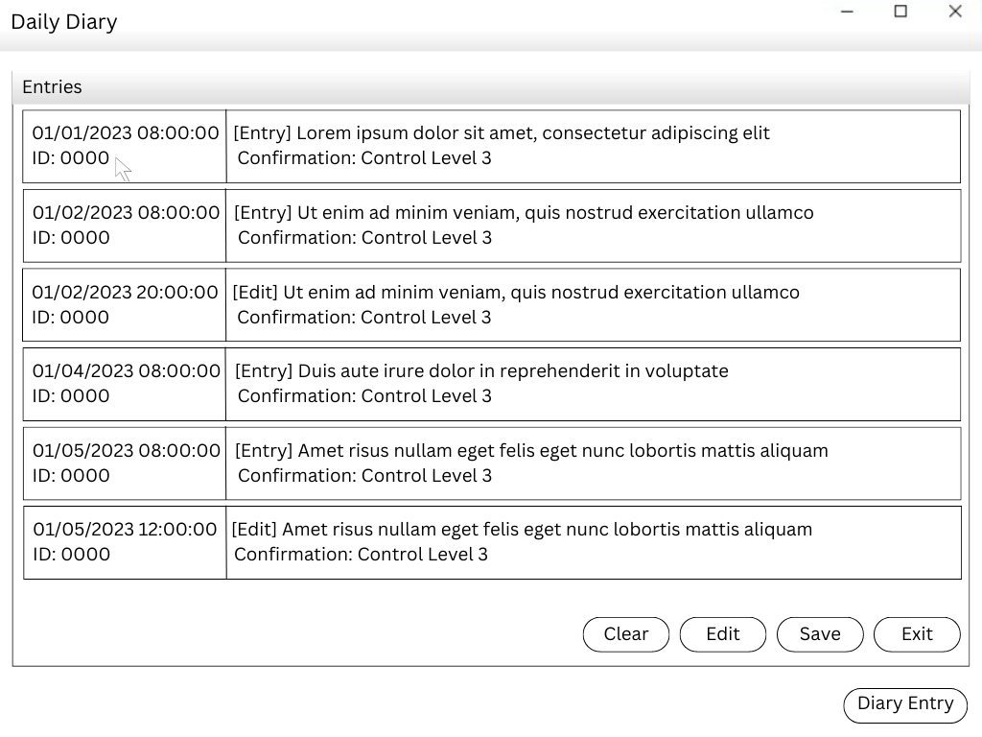
Daily Diary Window
3.3.7.1 Operator command and confirmation actions shall be recorded in the Daily diary
3.3.7.2 The Daily Diary Window shall show the date and time of the entry.
3.3.7.3 The Daily Diary Window shall show the ID of the operator for each entry.
3.3.7.4 The Daily Diary Window shall provide a button (labeled Diary Entry) to activate a screen (Diary Entry) for the operator to make a Diary entry.

Slide 20
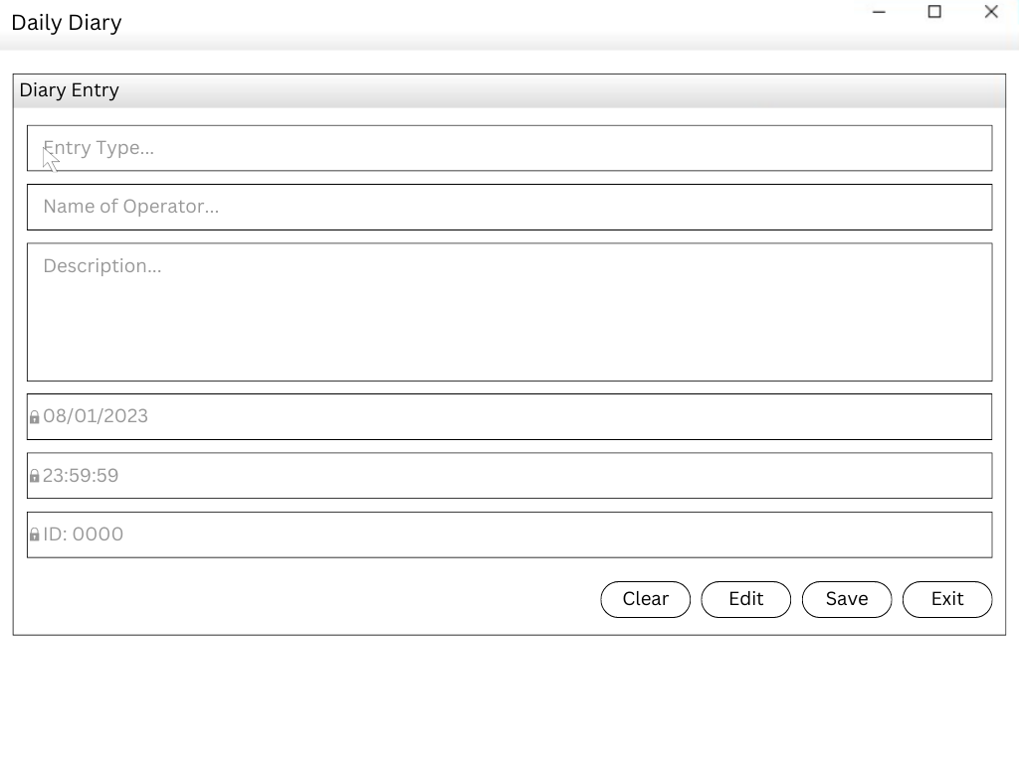
Daily Diary Window
3.3.7.5 The Diary Entry screen shall provide the operator with a form to make an entry in the Daily Diary.
3.3.7.6 The current date, time and operator ID shall be displayed on the form in read-only display fields.

Slide 21
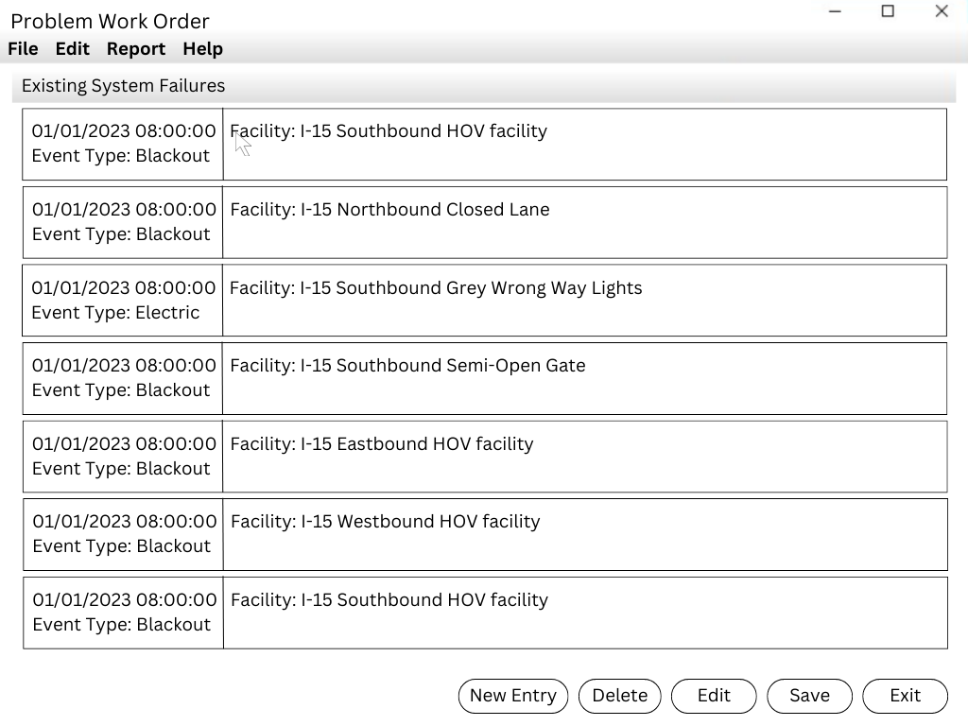
Problem Work Order Window
3.3.8.1 The Problem Work Order Window shall allow the User to enter, modify and close information about a system failure.
3.3.8.1.1 The Problem Work Order Window shall have a menu bar with File, Edit, Report and Help.

Slide 22
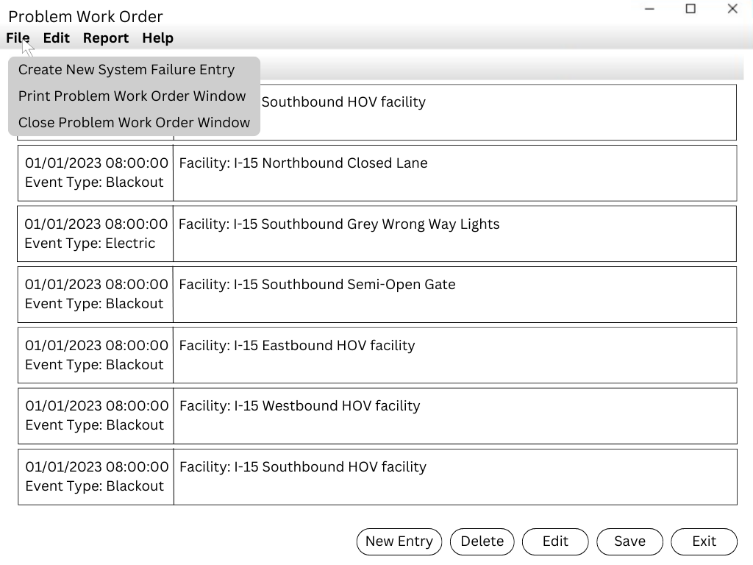
Problem Work Order Window
3.3.8.1.1.1 The File menu item shall have an option to create a new system failure entry.
3.3.8.1.1.2 The File menu item shall have an option to print the Problem Work Order Window.
3.3.8.1.1.3 The File menu item shall have an option to close the Problem Work Order Window.

Slide 23
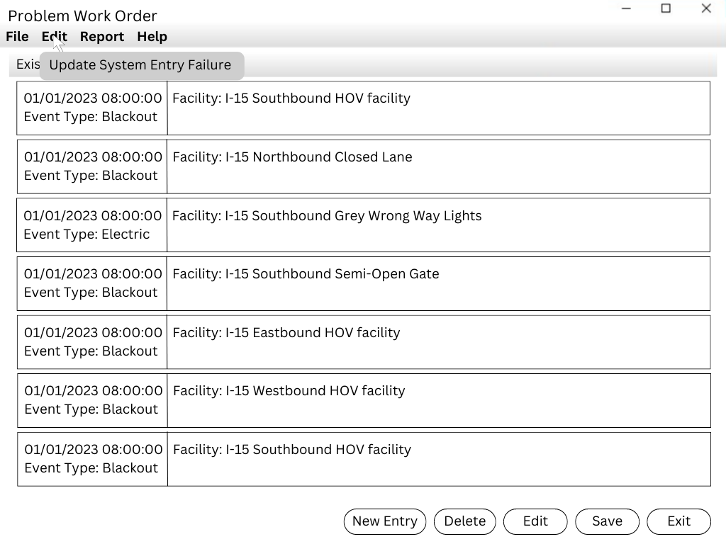
Problem Work Order Window
3.3.8.1.1.4 The Edit menu item shall have an option to add an update to an existing system failure.

Slide 24
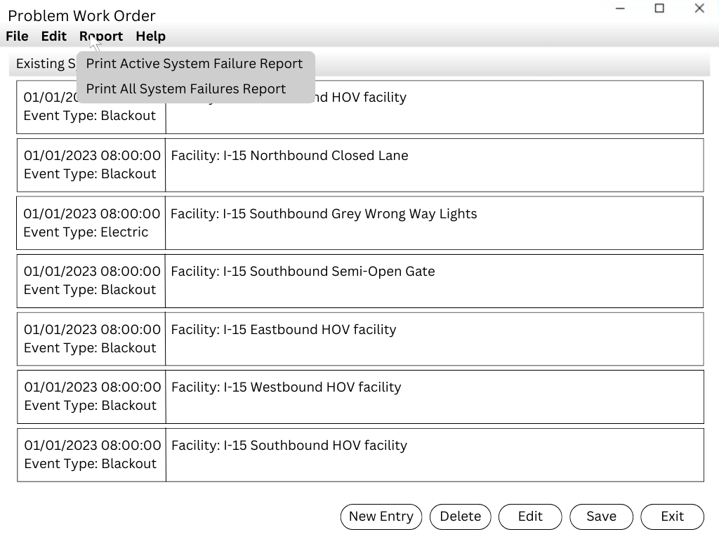
Problem Work Order Window
3.3.8.1.1.7 The Report menu item shall include an option to print all entries associated with a specific system failure.
3.3.8.1.1.5 The Report menu item shall include an option to print all entries associated with a specific device.
3.3.8.1.1.6 The Report menu item shall include an option to print a summary of all active system failures.

Slide 25
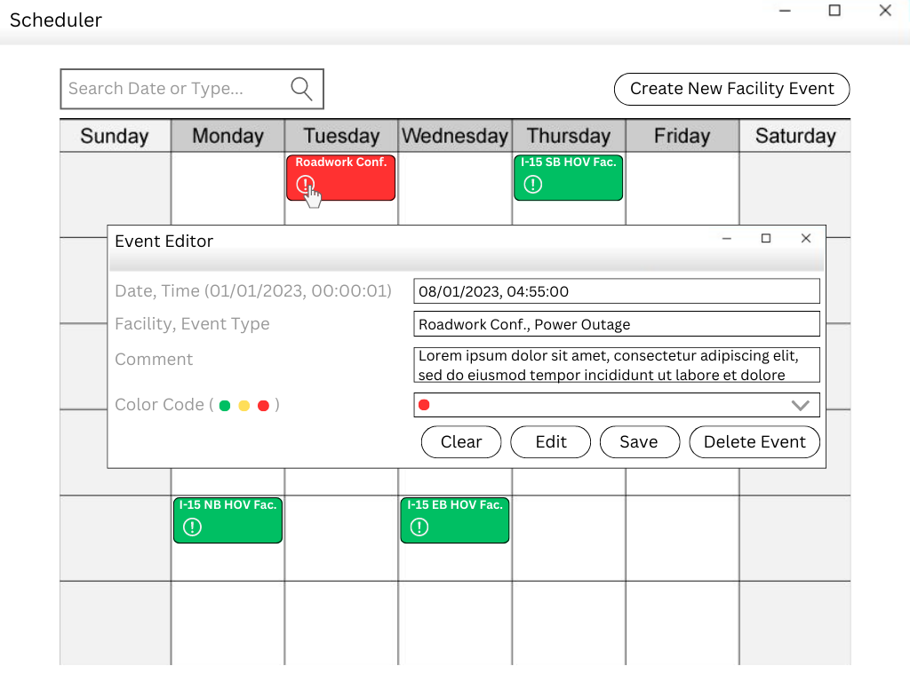
Scheduler Window
3.3.9.1 The Scheduler Window shall allow the user to enter, modify, delete and view information on events that affect the facility.
3.3.9.2 The user shall be able to search for specific events by date and type.

Slide 26
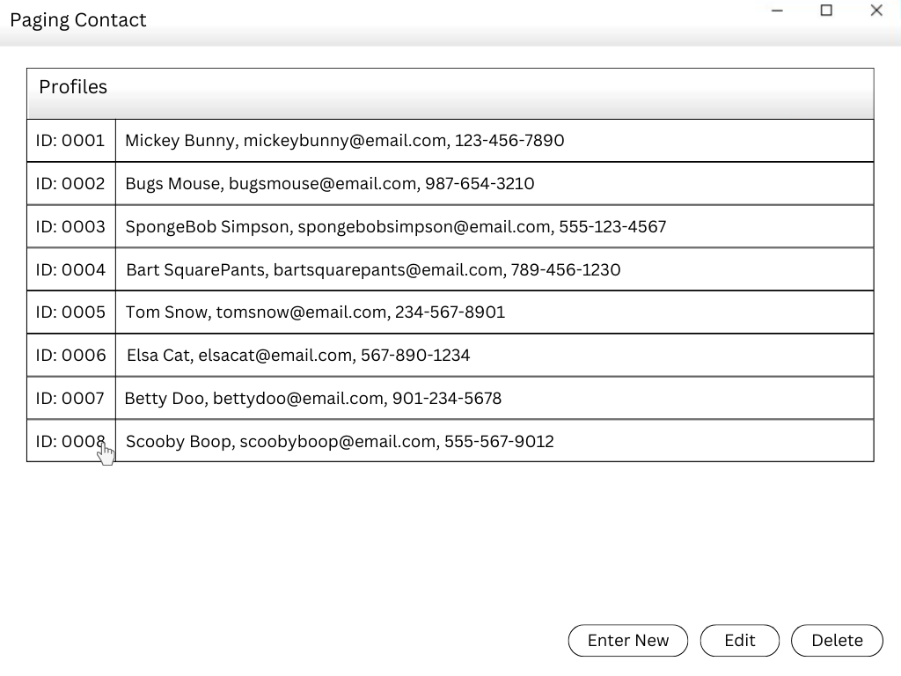
Paging Contact Window
3.3.10.1 The Paging Contact Window shall allow an authorized user to enter, modify and delete a paging profile for various points of contact.

Slide 27
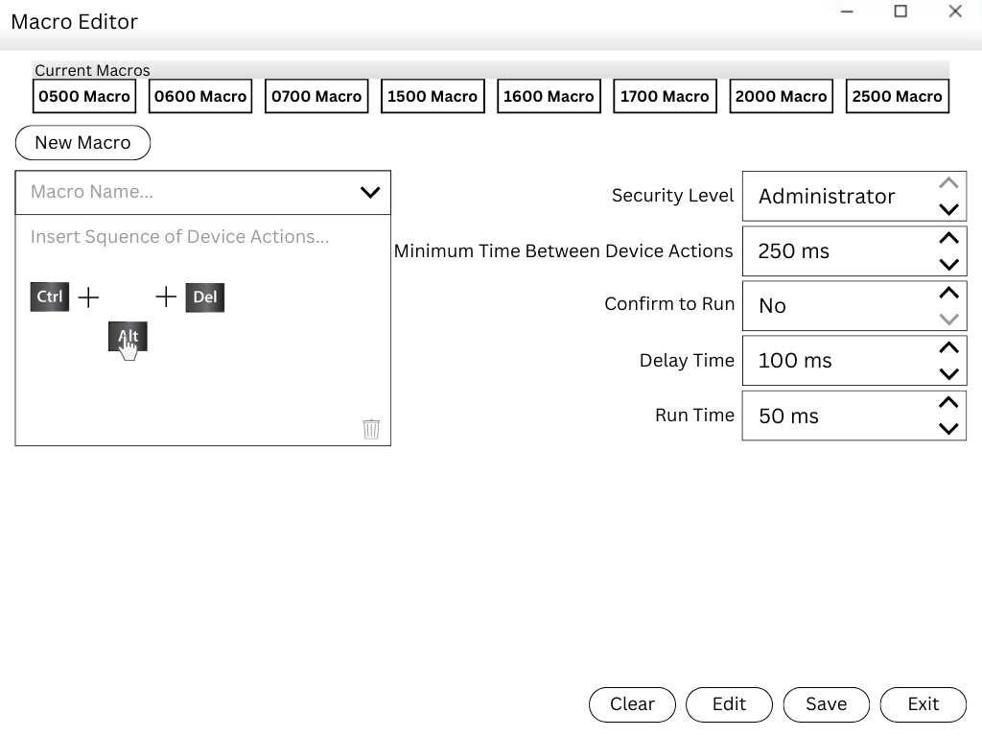
Macro Editor Window
3.3.11.1 The user shall select an existing macro to be edited or to define a new macro.
3.3.11.2 The operation being implemented shall determine which operations are permissible.
3.3.11.3 The Macro editor shall allow the user to insert a device action into a macro.
3.3.11.4 The Macro editor shall allow the user to delete a device action from a macro.
3.3.11.5 The operator shall be able to modify the order of the actions by selecting an action with the mouse and dragging the action to a new location in the macro.

Slide 28
Macro Editor Window
3.3.11.6 The Macro editor shall allow the user to specify a security level on a macro.
3.3.11.7 The Macro editor shall allow the user to specify a minimum delay time between device actions.
3.3.11.8 The Macro editor shall allow the user to specify that operator confirmation is required prior to starting a device action
3.3.11.9 The Macro editor shall allow the user to specify a valid time of activation for the macro.
3.3.11.10 The Macro editor shall allow the user to specify the expected amount of time an action will take to complete.

Slide 29
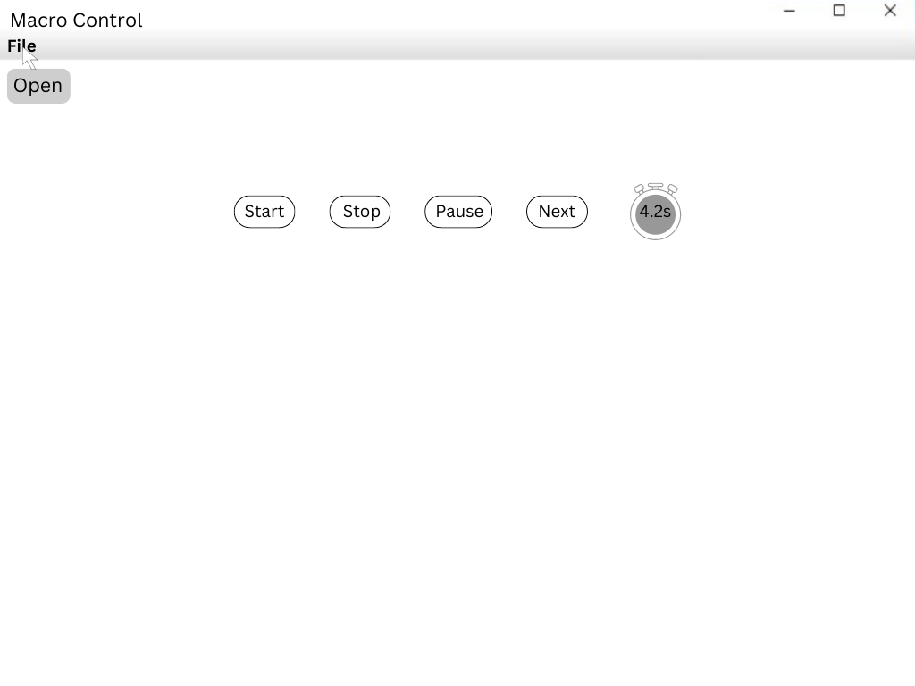
Macro Control Window
3.3.12.1 The Macro Control Window shall provide a File entry on the menu bar.
3.3.12.5 The Macro Control Window shall provide a button (labeled Stop) to halt execution of the macro execution.
3.3.12.2 The Macro Control Window shall provide an Open entry under the File entry on the menu bar.
3.3.12.6 The Macro Control Window shall provide a button (labeled Next) to execute the next action in the sequence.
3.3.12.3 The Macro Control Window shall provide a button (labeled Start) to start the macro
3.3.12.7 The Macro Control Window shall provide a counter showing the elapsed time since the macro execution was started.
3.3.12.4 The Macro Control Window shall provide a button (labeled Pause) to pause the macro execution.

Slide 30
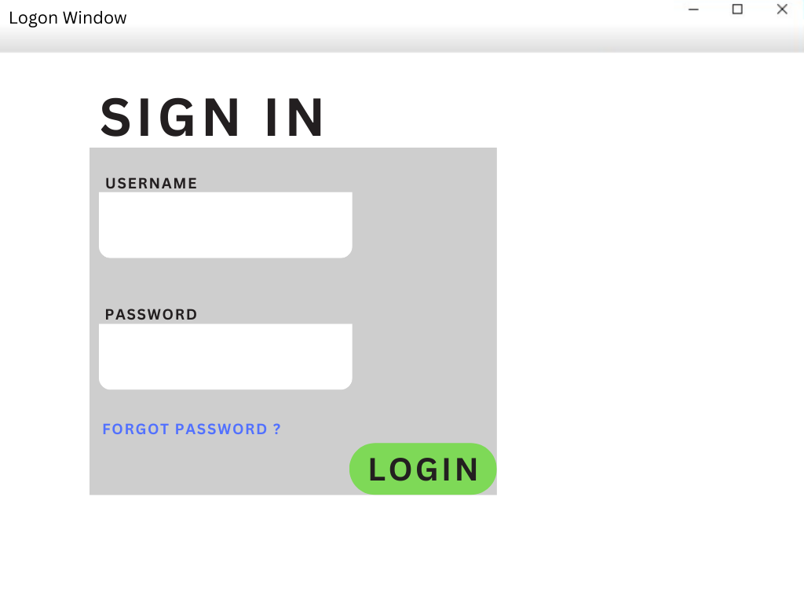
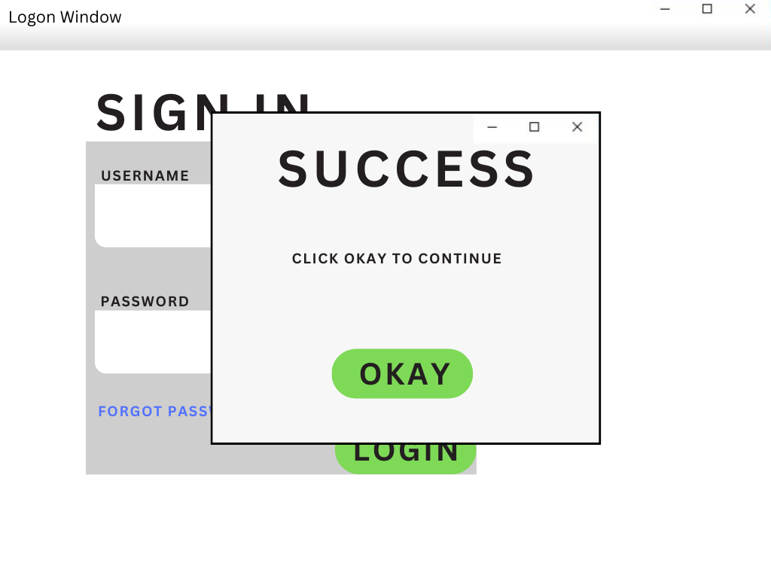
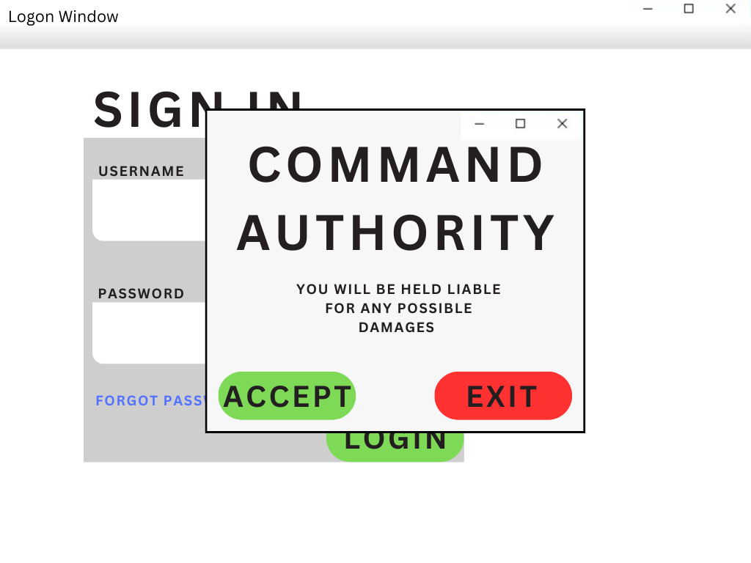
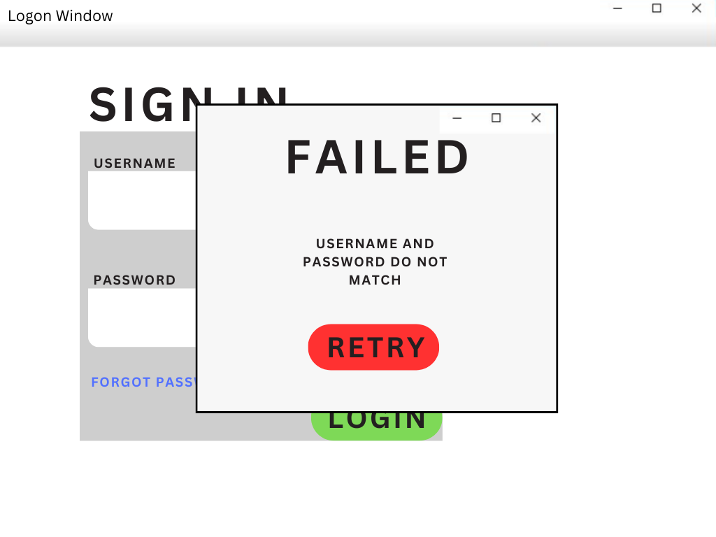
Logon Window
3.3.13.1 The Logon window shall enable a user to enter a user name and password.
3.3.13.2 The Logon Window will indicate to the user if the user name and password were accepted.
3.3.13.3 The Logon window shall allow the user to accept or reject command authority for the system.

Slide 31
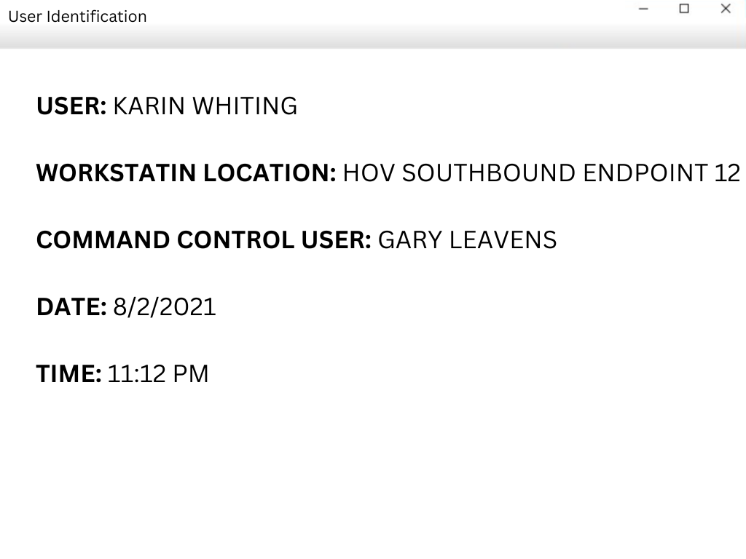
User Identification Window
3.3.14.1 The User Identification Window shall display the name of the user logged at this workstation, the location of the workstation, the name and location of the user with command control (the operator) and the date and time.
3.3.14.2 The User Identification Window shall always be displayed.

Slide 32
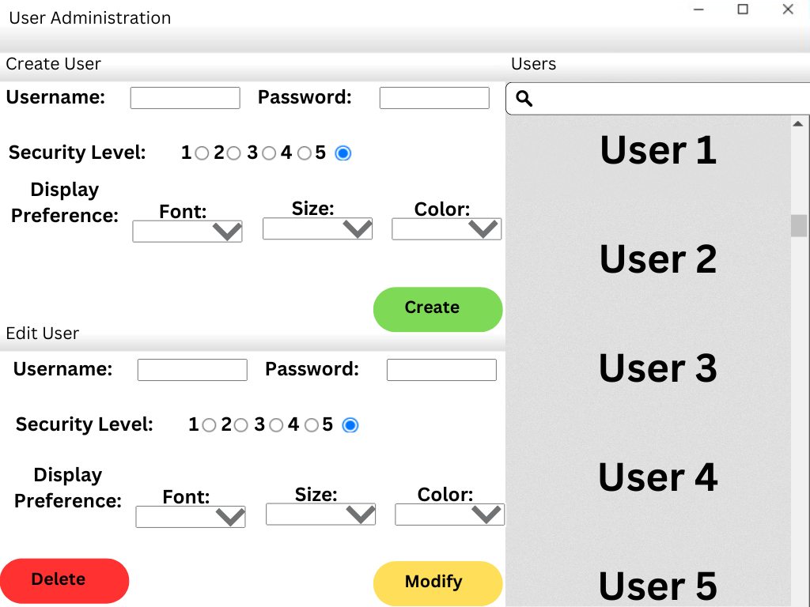
User Administration Window
3.3.15.1 The User Administration Window shall allow a properly authorized operator to enter/modify/delete user names, passwords, user security level and use display preferences.

Slide 33
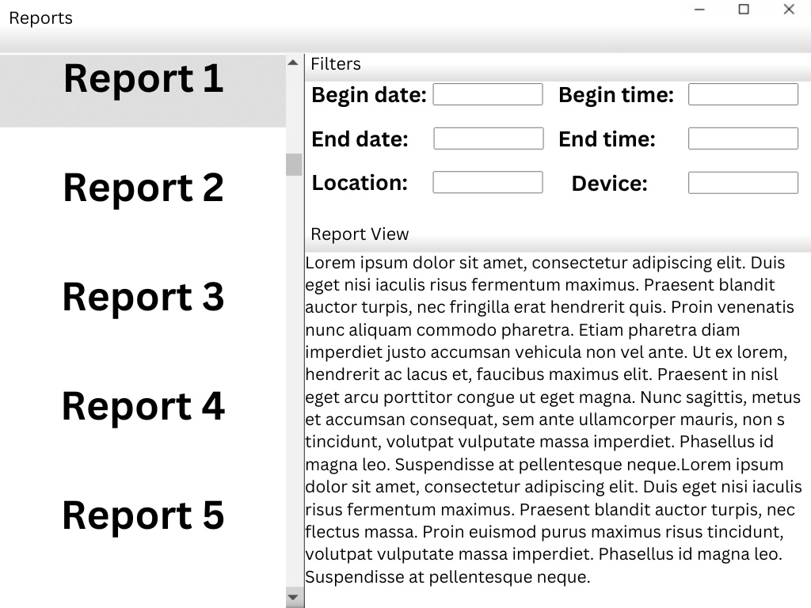
Report Windows
3.3.16.1 The Report Windows shall allow the user to select and view reports generated by the system.
3.3.16.2 The Report Window shall allow the user to select the information to be included in a report format, including the time frame the report is to cover

Slide 34
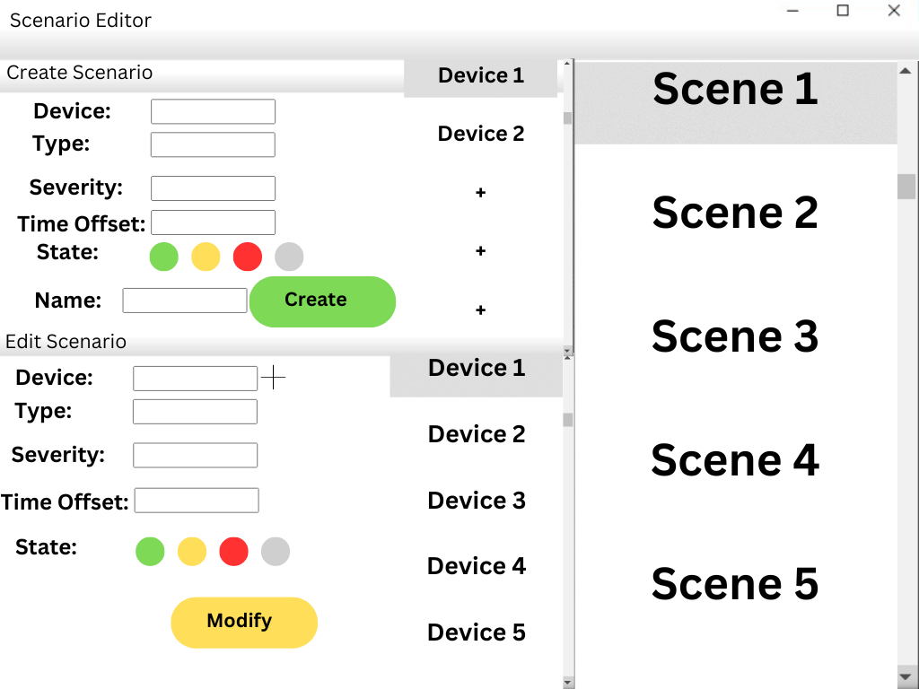
Scenario Editor Window
3.3.17.1 The Scenario Editor shall provide the operator with the ability to create new scenarios.
3.3.17.2 The Scenario Editor shall provide the operator with the ability to modify existing scenarios.
3.3.17.3 The Scenario Editor shall provide the operator with the ability to define the state of all devices: operational, failed, unknown.
3.3.17.4 The Scenario Editor shall provide the operator with the ability to define equipment malfunctions by an offset time from the start of the scenario.

Slide 35
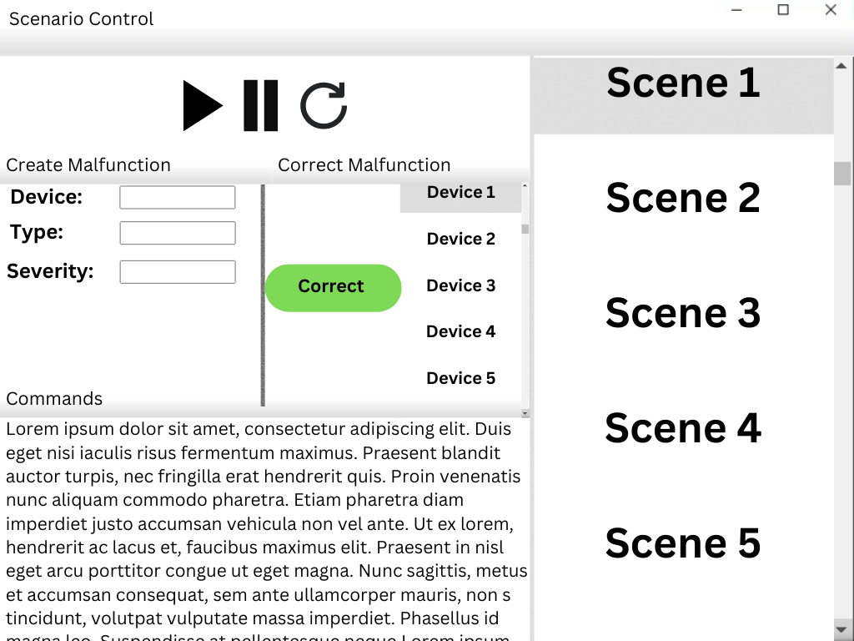
Scenario Control Window
3.3.18.1 The Scenario Control Window shall provide the training user the ability to start a scenario. 3.3.18.2 The Scenario Control Window shall provide the training user the ability to pause a scenario. 3.3.18.3 The Scenario Control Window shall provide the training user the ability to restart a scenario. 3.3.18.4 The Scenario Control Window shall provide the training user the ability to correct device malfunctions. 3.3.18.5 The Scenario Control Window shall provide the training user the ability to create device malfunctions. 3.3.18.6 The Scenario Control Window shall provide the training user the ability to see all commands issued by the trainee user.

Slide 36
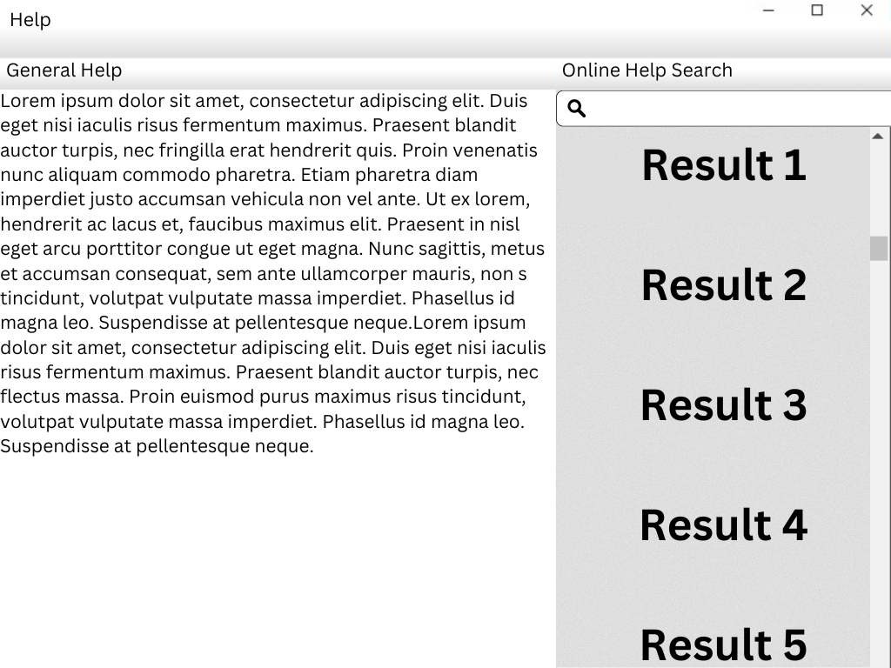
Help Window
3.3.19.1 The Help Window shall allow the user to request and display help information.

Slide 37
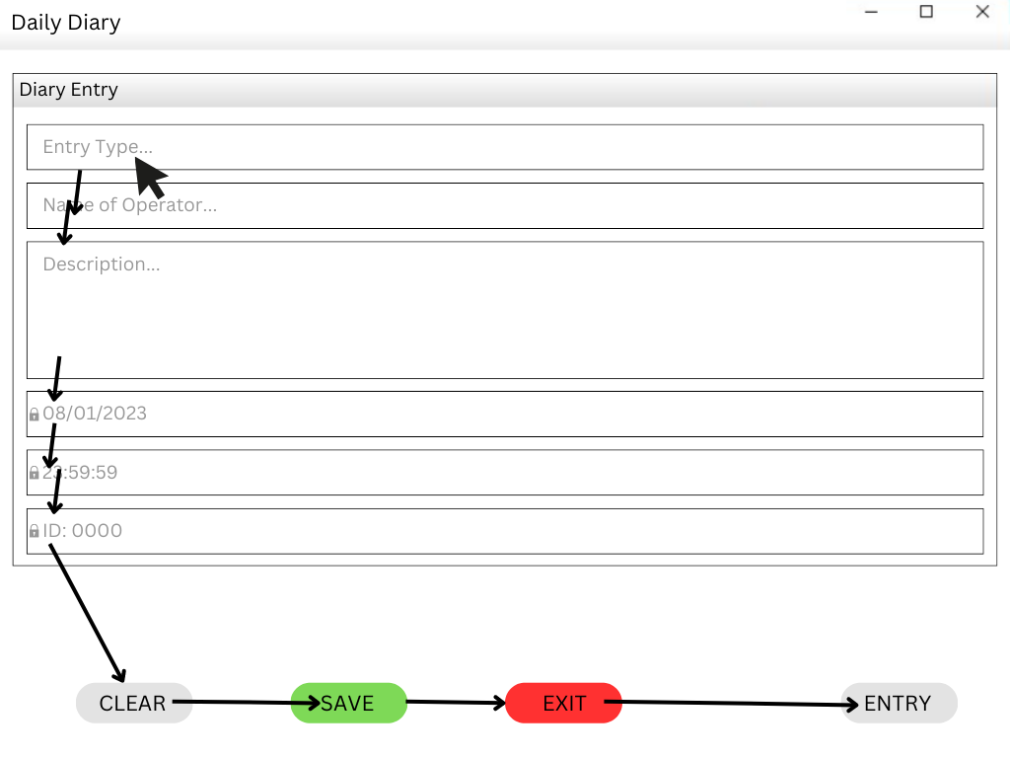
Field Validation
4.1.3.1 If a user entry must be one of several defined items, then the system shall present the user with the list of items from which to select the entry.
4.1.3.1.1 The form window shall be sized to display a minimum of 5 items from the selection list.

Slide 38
HTI Discussion
Aesthetic and Minimalist Design: The interface implements a minimalist design that features plenty of white-space, consistent font styles and sizes, and a color palette that makes the content easily readable and understandable.
Learnability and Memorability: The interface does not overload the user with content and the features are intuitively placed and labeled, allowing for users to both learn and remember how to use the platform with ease.
Error Prevention: In addition to the other principles, the utilization of clear/save/edit options help to limit errors when the user interacts with this interface.

